Slide 1
Leveraging Cross-institutional Academic Collaboration to Build Collective Impact within a Community-based Substance Misuse Coalition
American Public Health Association Annual Meeting 2020

Slide 2
Leveraging Cross-institutional Academic Collaboration to Build Collective Impact
within a Community-based Substance Misuse Coalition
Erin Magee, MSW, MPH
Emma Olson, MSW, MPH
Kathryn Gaasch, MEM
John Wallace, PhD, MSPH
Notes:
Thank you Jessica for the introduction. Hello everyone, it’s great to be with you today, if that’s late afternoon or evening, depending on where you’re joining from. I’m joining rom Durham, NC, where it’s a little after dinner time. As I imagine many of us who are working with communities are feeling, this presentation I’m about to give is going to be a little different than I’d originally envisioned when I submitted my abstract back what feels to be 18 years ago in February. So much has changed since then, and I imagine all of us working with communities in these academic community partnerships are feeling in the same boat!

Slide 3
Project Background
Notes:
Today, I’ll give you a little background of the project and the different institutions involved, spend most of my time describing our process and what guided our decision points.

Slide 4
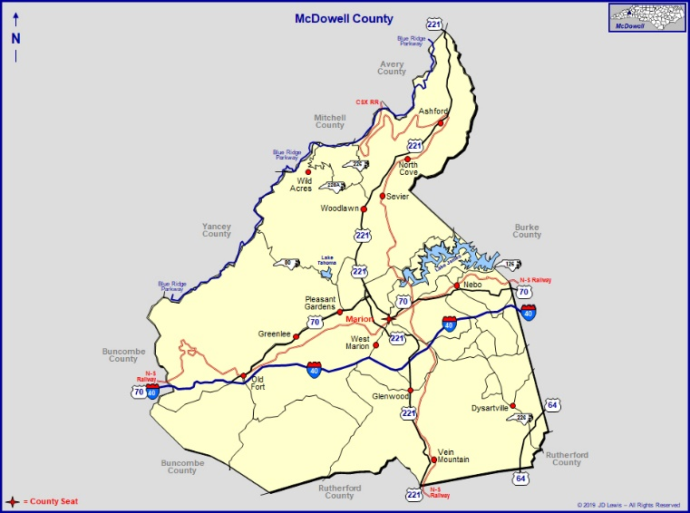
Collaboration Partners
McDowell County Substance Use Workgroup
Notes:
Through a grantmaking initiative to provide technical support to rural communities in North Carolina, the community-led McDowell County Substance Use Workgroup formed a collaborative relationship with academic partners from the North Carolina Institute for Public Health at the Gillings School of Global Public Health at the University of North Carolina at Chapel Hill (NCIPH) and the North Carolina Center for Health and Wellness at the University of North Carolina Asheville (NCCHW). Going forward, I’ll be referring to this partnership as the “TA team.”
As part of the grant, the funder also provided facilitation support from Rural Forward NC, a program out of the Foundation for Health Leadership and Innovation. While not officially the “TA team”, we’ve adopted them and their work and thoughtful contribution has been integral to our process and any success we’ve had.
(Image source: https://www.ncpedia.org/geography/mcdowell and https://www.carolana.com/NC/Counties/mcdowell_county_nc.html)

Slide 5
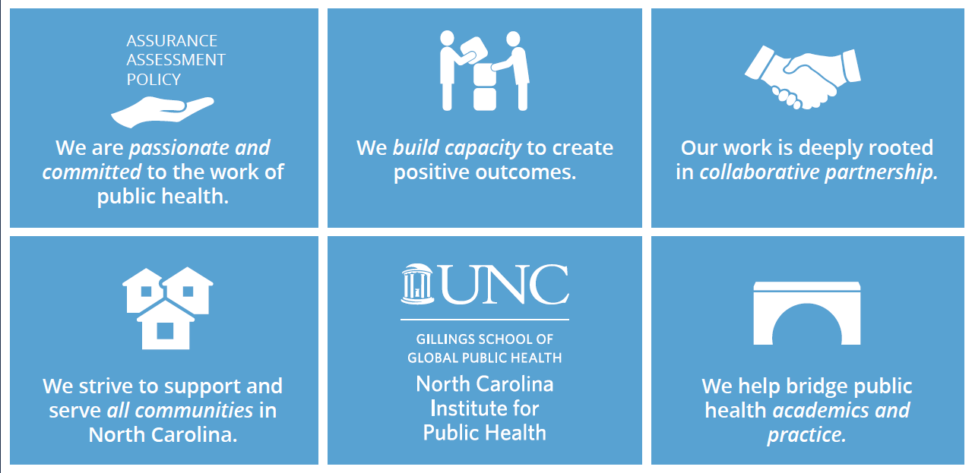
North Carolina Institute for Public Health (NCIPH)
Mission: To facilitate collaborative solutions to population health challenges in N.C. and beyond
Notes:
A little bit about NCIPH, where I sit along with my colleague Dr. John Wallace.
The mission of NCIPH is: To facilitate collaborative solutions to population health challenges in N.C. and beyond. In this role, the Institute provides technical assistance and training for community-based organizations, governmental entities, and grantmaking organizations across North Carolina. NCIPH assists local community coalitions and public health agencies with the analysis and interpretation of community data to inform strategic thought and decision making, and Dr. Wallace is our resident data head.
We’re the “pracademics” and our work is very applied in its orientation.

Slide 6
North Carolina Center for Health & Wellness (NCCHW)
Located within the University of North Carolina Asheville
Mission: Develop equitable opportunities that lead to healthy North Carolina communities.
Works “to impact policy, build capacity, and ignite community initiatives by working through a web of cross-sector relationships organized around building healthier places throughout the state.”
Training and technical assistance support partners in understanding strengths and needs, measuring
impact and improving results
Notes:
Our sister university, UNC-Asheville, is where the North Carolina Center for Health and Wellness is located, and where my colleague Emma Olson, who is supporting me in the audience today, sits. Their mission is to “develop equitable opportunities that lead to healthy North Carolina communities” and they work to impact policy, build capacity, and ignite community initiatives by working through a web of cross-sector relationships organized around building healthier places throughout the state.
One of the strengths they brought to the TA team is their geographic proximity to McDowell County, and the in relationships they have with organizations and collaboratives in neighboring counties; Emma brought deep familiarity with recent community processes of data collection and action planning in the region, as well as a toolkit of Results Based Accountability (RBA) approaches, facilitation experience, and training.
So, you can already see that two institutions is better than one.

Slide 7
Rural Forward North Carolina
Rural Forward NC is a program of the Foundation for Health Leadership and Innovation.
Supports individual leaders, their organizations, and the county coalitions that are actively working to make their rural counties healthier and more thriving.
Works collaboratively with the Kate B. Reynolds Charitable Trust to build leadership capacity, provide program-wide guidance, identify opportunities for community collaboration, and develop technical assistance and support programs in 10 rural NC counties.
Notes:
Kathryn Gaasch played the role of our Rural Forward facilitator. She organized meetings, took notes, facilitated discussion, collected monthly meeting evaluations and reported back to the Workgroup. But lest it sound like she was administrative in nature, Kathryn played the critical role of being the “backbone organization” that did a lot of coaching and behind the scenes support that addresses the dynamics of the community and holding the trust of many partners.
Early on, Kathryn led an exercise with the community coalition to define and focus their Vision Mission and Values, a process that became a key input into our processes and helped guide the work we did.

Slide 8
McDowell County Substance Use Workgroup
Community led coalition of 62 stakeholders representing 39 organizations, providers and the community
Structure of leadership group, full group, and action groups
Leadership and full groups meet monthly
Technical assistance (TA) provided by cross-institutional academic collaborative
Notes:
And finally, at the heart of the whole project, the McDowell County Substance Use Workgroup. McDowell County is located in the mountains of Western NC. In 2019, the population was approximately 45k, and it is designated a rural nonmetro county.
Substance use is a key concern for the community, and the Workgroup formed to respond to the need for prevention and recovery services for a wide range of substances, including opioids, methamphetamines, and alcohol. The Workgroup is made up of sixty-two stakeholders representing 39 various organizations, providers, and individuals from the community who have been impacted by substance use. One of the strengths of the Workgroup was it’s cross-sectoral nature: members were representatives of the local hospital system, behavioral health providers, the Managed Care Organization (LME/MCO, which in North Carolina is the provider of behavioral health needs for Medicaid and uninsured patients), as well as first responders such as EMS and law enforcement, and representatives from faith communities, non-profits, food banks, the school systems, and as residents. It really represented a range of intersections with substance use, and a range of moments for intervention from prevention to recovery.
When we began, the structure of the group was a leadership group and full group. Through work we helped facilitate, the full group has self-assigned to small action groups around different topic interests and expertise, but I’ll talk more about that later. Both leadership and full group met monthly, and until Covid-19 that had been in-person in Marion, NC, which is the county seat of McDowell County.

Slide 9
Project Description

Slide 10
Project Description, Methods, Timeline
3yr Project (Jan 2019 – Dec 2021)
Data Gathering
Strategic Planning & Development
Empowerment for Implementation
Identify short-term needs, strategize for long-term success
Support workgroup efforts around strategic planning for treatment, recovery, and prevention
Use new and existing data/resources to quantify needs
Build the rationale for further investment in sustainability & coordination of care and resources
Notes:
The purpose of this applied project was to build the Workgroup’s capacity in their behavioral health improvement collaborative to develop impactful, sustainable, and community-driven initiatives targeted at reducing the rates of substance misuse and overdose deaths.
While originally the RFA we responded to placed an emphasis on gathering, analyzing, and visualizing data, during our interview with the Substance Use Workgroup they shared that they felt they already had enough data to go on through other data collection efforts that had been undertaken, and felt real urgency to align and move the workgroup toward action. As they said “people are dying.”
This led to an approach of parallel processes, where some of our work was focused on identifying short-term needs and others focused on strategizing for long-term success. As we supported the Workgroup in using the data and resources they had, we also sought to help them bring alignment of partners around shared strategy for long-term investment and coordination.

Slide 11
Desired Results of Collaboration
Shared knowledge & expertise
Cross-institutional collaboration utilizes strengths of each organization
Broad perspective from across NC based on prior work of each institution
Shared power
Cross-institutional collaboration is a partnership rather than hierarchy
TA model ensures community maintains power & voice
Objectivity
Community-driven work supported by “outside” TA providers
Support workgroup with state & national perspective and context applied to local driven solutions
Notes:
We wanted to foster a partnership where different strengths and expertise were aligned in service to the community goals. We wanted our cross-institutional collaboration to utilize the strengths we both brought.
And, most importantly, we wanted a partnership, rather than a hierarchy, and using the TA model rather than a traditional academic research lens, was the method we chose to ensure the community-maintained power and voice.
This approached placed an emphasis on our own objectivity: it was the community-driven work supported by us, rather than our research interests driving the project.

Slide 12
Strategic Planning Roadmap
2. Focus Area Validation
Present Strategic Directions to workgroup for feedback and validation
3. Strategy Prioritization
Ranking strategies by feasibility and impact to select priority strategies
5. Action Planning
Groups develop action plans for 1-2 strategies to begin harnessing collective resources and “diving deeper” into.
1. Community Inputs
Review existing recommendations, evidence-based strategies and facilitate RBA community input exercise
6. Performance Measures
Select metrics for the action steps developed to choose ways to measure success.
4. Strategy Priority Validation
Review outcomes from Strategy Prioritization for validation and feedback
Notes:
One of the first processes that the TA team undertook was to synthesize and align the community inputs and existing data and needs assessment. This is our “step 1”, seen in the left side of the road map. The inputs included three community data and best practices documents and the State Opioid Action Plan.
The TA team cross-walked these documents for themes and grouped the themes according to related focus areas. These focus areas were then reported back to the Workgroup for validation and feedback. The final four strategy focus areas were:
Sustain and strengthen partnerships and collaborations
Prevention, awareness and outreach
Treatment, recovery, and prevention services
Improve social determinants of health related to substance use and mental health

Slide 13
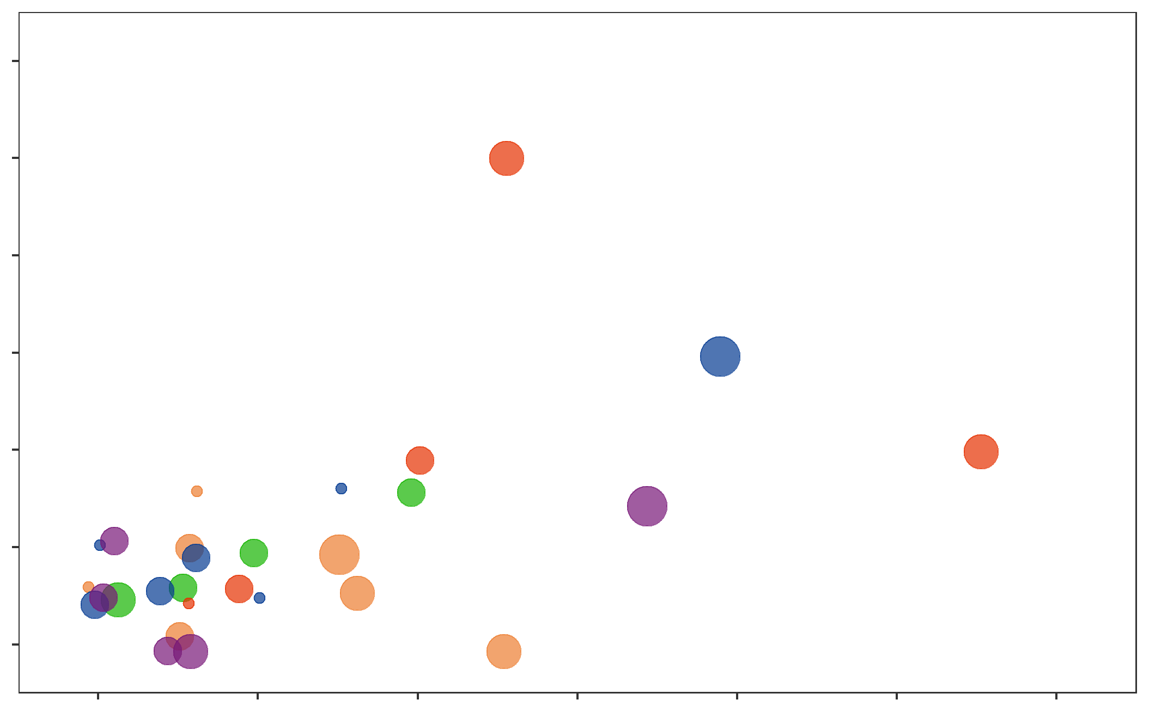
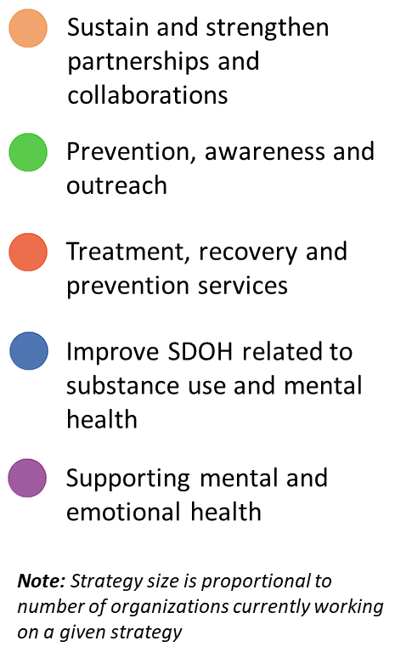
Prioritizing Strategies
Impact & Feasibility of All Strategies That Received Votes
Most Impact
12
Additional recovery services
Strategy Focus Area
8
Connecting people with resources
Impact Votes
Reentry/ employment support
Implement MAT
Engage families
4
Educational campaigns
Address stigma
Peer support specialists
Community forums & engagement
Track & evaluate impact
0
Resource list/database
Least Impact
0
4
8
12
Least Feasible
Feasibility Votes
Most Feasible
Notes:
Once the four focus areas were decided on, the Workgroup formed small Action Groups around each one based on expertise and interest. Together these small groups reviewed the strategies within each focus area, and voted on strategies by impact and feasibility. That is what you see on this slide demonstrated with the scatterplot. The Y axis plots the impact, and the X axis the feasibility. For example, resource list/database scored reasonably feasible, but with lower impact than, say, implementing medically assisted treatment (MAT). The size of the dots corresponds to the number of organizations working on a given strategy to the relative number of organizations. Going back to what I said earlier about that urgency to start doing, this helped the Workgroup identify the “low-hanging fruit” that they could bite off and make a dent in while still working toward those more impactful long-term strategies, such as additional recovery services, that would take time to come to fruition. For example, the Workgroup wants to see a detox center in the County, but the groundwork for that has yet to be laid.

Slide 14
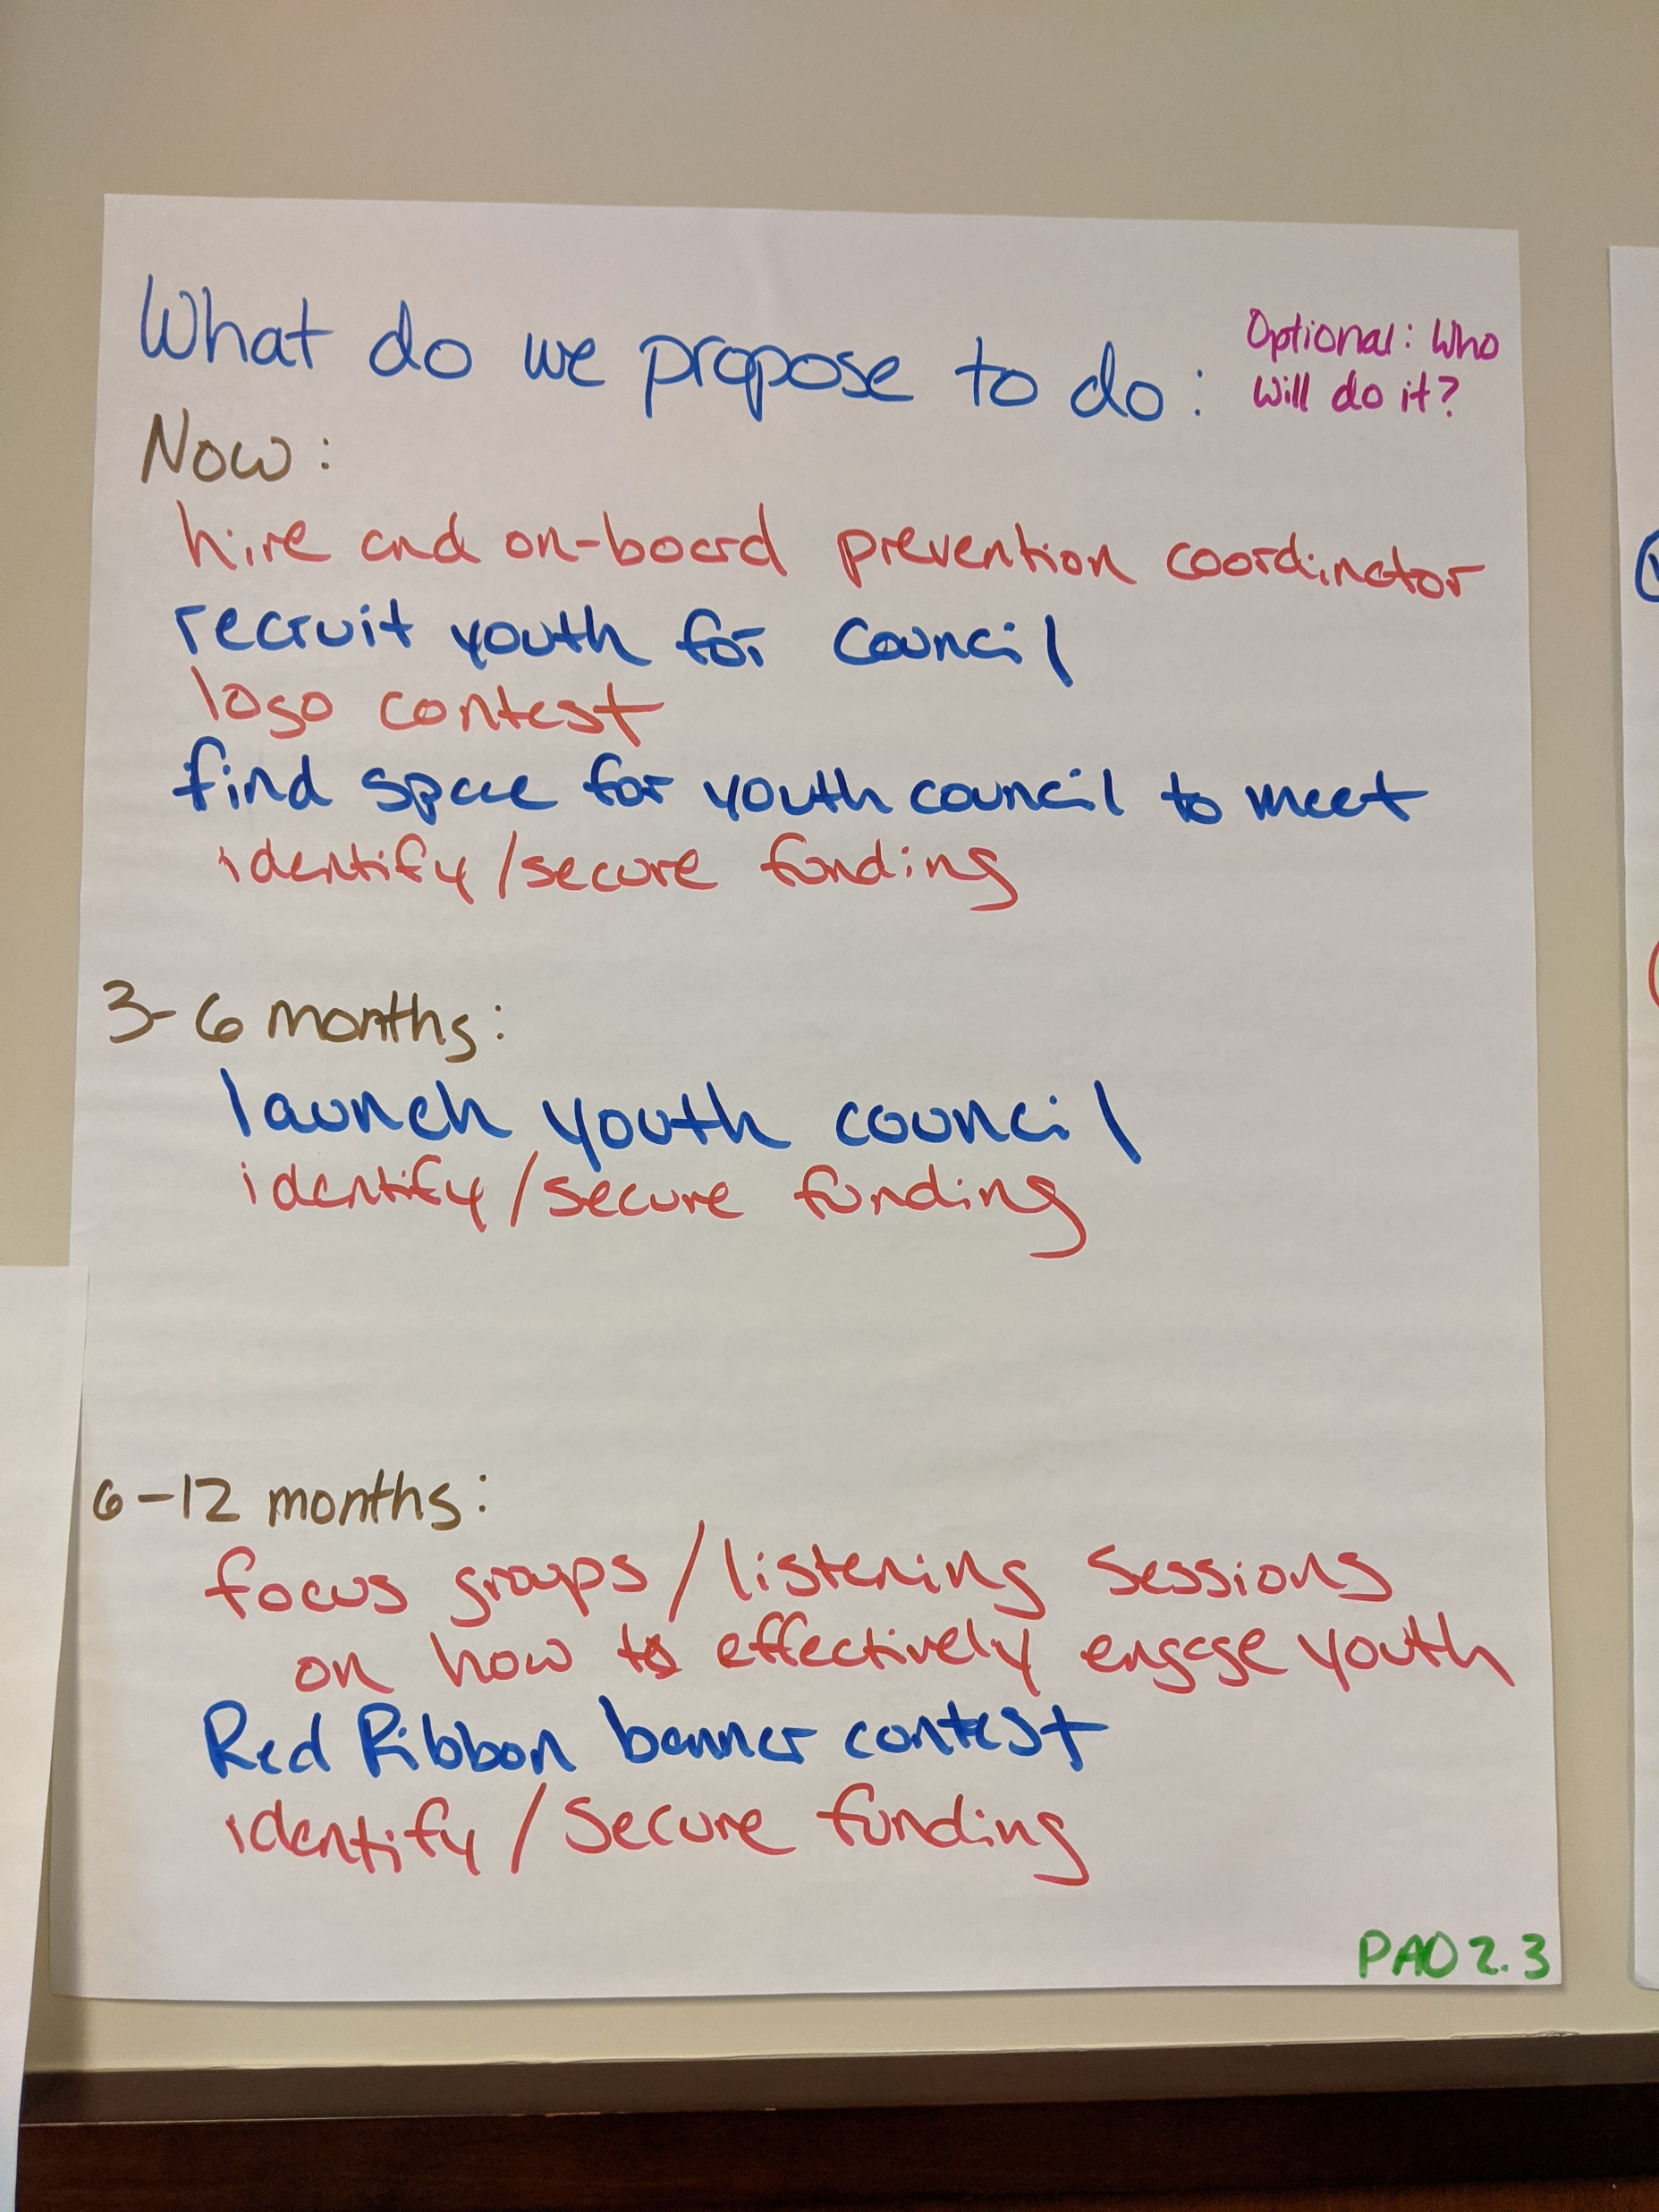
Results-Based AccountabilityTM Planning Process
Notes:
After the priorities were selected for each Action Group, using an RBA framework, the TA team led participants through a process of identifying key “customers” or target population for each focus area and priority strategy and identifying the results and changes that they want to see, what is helping (i.e., the facilitating factors) and what is hurting (i.e, the barriers to) these outcomes in the community currently, and what we propose to do now, in the next 3-6 months, and the year.
What you see on this slide is the proposed action items from the Prevention, Awareness and Outreach group which focused heavily on youth and the school systems. The actions identified included “hire and on-board prevention coordinator”, “recruit youth for youth council” “find space for youth council to meet”
The proposed actions were then in the process of being converted to key metrics that could be tracked to help measure and indicate progress. This is actually quite difficult because wanting data means…you have to gather it, right? And you’re asking a lower-resourced community to put additional efforts into tracking data, which is burdensome. You also have the cross-sectoral nature of the work, where frameworks and definitions may vary a bit depending on organization. Like a puzzle, it fits together, but each piece is a little different shape.

Slide 15
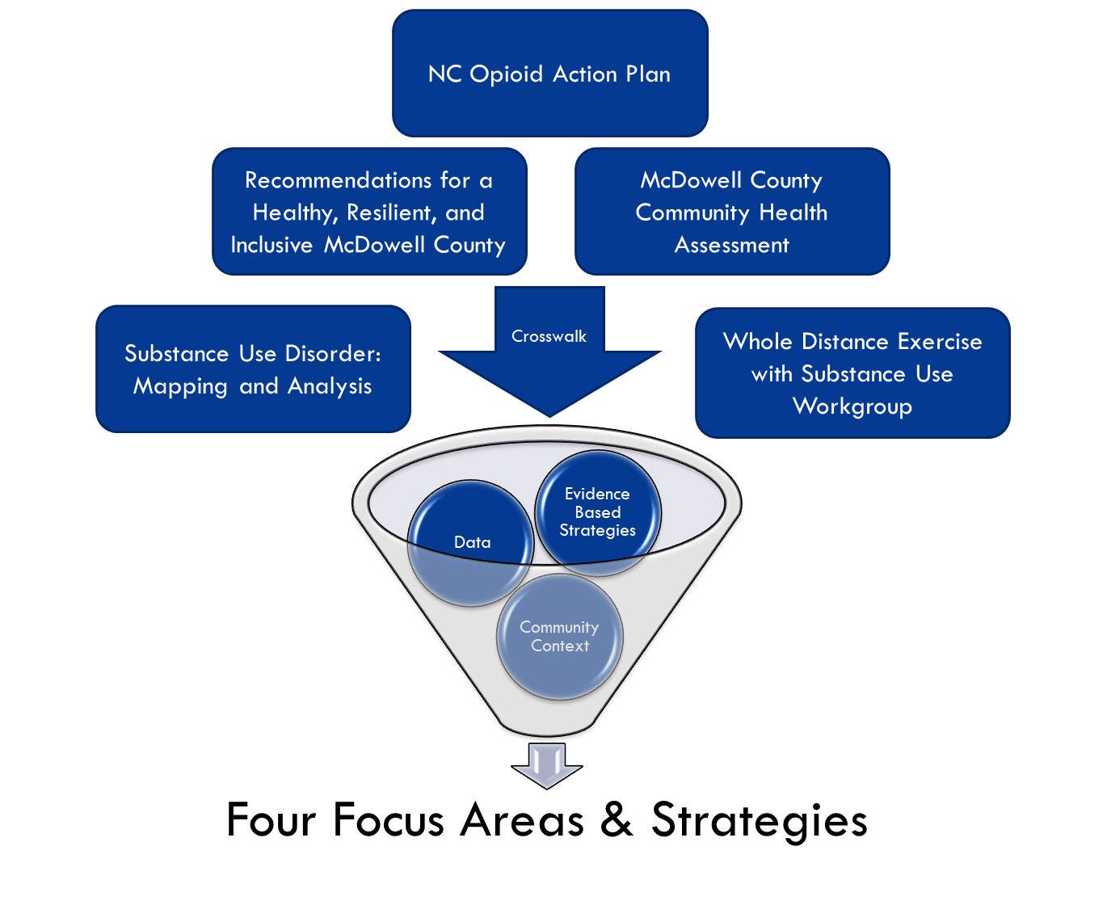
Process Outcomes
Strategic Action Plan
Different strategic areas selected from community inputs through a process of Substance Use Group discussion and voting and action groups formed around them
Action groups began identifying metrics to track to identify success and forward motion
Collaborative Partners Leveraging Strengths
Facilitation and Results-Based Accountability (RBA) from NCCHW
Data collection, analysis and support from NCIPH
Coordination and facilitation of Workgroup by Rural Forward NC
Notes:
But, none the less, we had a streamlined strategic action plan, based on data and evidence from the community, chosen by the Workgroup, that aligned desired results with strategies and focus areas, that were being converted to metrics.

Slide 16
Strategic Planning Roadmap
2. Focus Area Validation
Present Strategic Directions to workgroup for feedback and validation
3. Strategy Prioritization
Ranking strategies by feasibility and impact to select priority strategies
5. Action Planning
Groups develop action plans for 1-2 strategies to begin harnessing collective resources and “diving deeper” into.
1. Community Inputs
Review existing recommendations, evidence-based strategies and facilitate RBA community input exercise
6. Performance Measures
Select metrics for the action steps developed to choose ways to measure success.
4. Strategy Priority Validation
Review outcomes from Strategy Prioritization for validation and feedback
Notes:
And the metrics piece is step 6. Performance Measures, and that’s where we were in February and, well, everyone knows what happened in March, 18 years ago, back when we were submitting our APHA abstracts.

Slide 17
COVID-19 Challenges
Challenges
Change to virtual meetings
Collaborative members responding to community needs
Increase in mental health and substance use needs
Lack of reliable internet access in some areas of the rural county
Rapidly changing picture of community outcomes
Unemployment
Schools closed
Food and nutrition needs increased
Collaborative Partners Leveraging Strengths
Partners’ varied skills and expertise allowed them to respond to coalitions changing needs as situation evolved
Surveyed members in September to assess members’ perspectives on how the coalition should move forward and feasibility of work for members
Notes:
Covid-19 brought a lot of challenges: most immediately, we were no longer meeting in person but in virtual meetings. Which, for a group building trust and relationships, fostering healthy group norms, and encouraging participation…that’s is a different format you’re dealing with! Specific to substance use and mental health providers, many of whom were in the Workgroup, suddenly there was an increase in need while an inability to meet in person which presented a huge challenge in a County with unreliable broadband and internet services in the most rural areas. Suddenly providers were spending their time setting up Wifi hotspots in the McDonalds parking lot so they could provide telehealth. And, of course, when we think of the social determinants of health as drivers of substance misuse and poor mental health, suddenly unemployment is rising, schools are closing, parents don’t have childcare, some children may not have food, etc. These are the things that have equal urgency in the community.
We’ve been navigating a difficult position, right: as a capacity building org that is following community lead, how do you pivot when you’re following the leadership of the community, and the community’s is having a hard time keeping up with their own work?
During the early months, the Workgroup became a space to update each other on what COVID-19 response was happening and some group problem solving and sharing. Some of the activities the TA team supported was helping train the local Health Department on interpretation of NC Detect data, which is the NC sentinel surveillance system for ED visits (including medication, drug, and alcohol related poisoning), out of concern that this may be increasing in the pandemic.

Slide 18
Survey: Pulse-check and Moving Forward
Six-months into the COVID-19 pandemic, the TA team conducted a survey of the workgroup to:
Build understanding of the workgroup members’ experiences, and perceived strengths, opportunities and priorities
Help the workgroup and leadership team decide next steps and where to channel energy over the next year and beyond
Drive internal improvement planning related to communication, functioning, member experience, resources, group effectiveness, etc.
Provide direction to TA team for how we could best support the work group in growing and moving forward
Notes:
As the “new normal” set in, though, there began to be a sense of frustration that the Workgroup had stalled. So, we called on our data team members to conduct a pulse-check survey to Build understanding of the workgroup members’ experiences and priorities, help the workgroup and leadership team decide where to channel energy, drive internal improvement planning related to communication, functioning, member experience, resources, group effectiveness, etc., and provide direction to TA team for how we could best support the work group in growing and moving forward.
The survey consisted of 21 questions disseminated through the online Qualtrics platform, focusing on the areas I just mentioned, that went out to the Workgroup during the month of September.

Slide 19
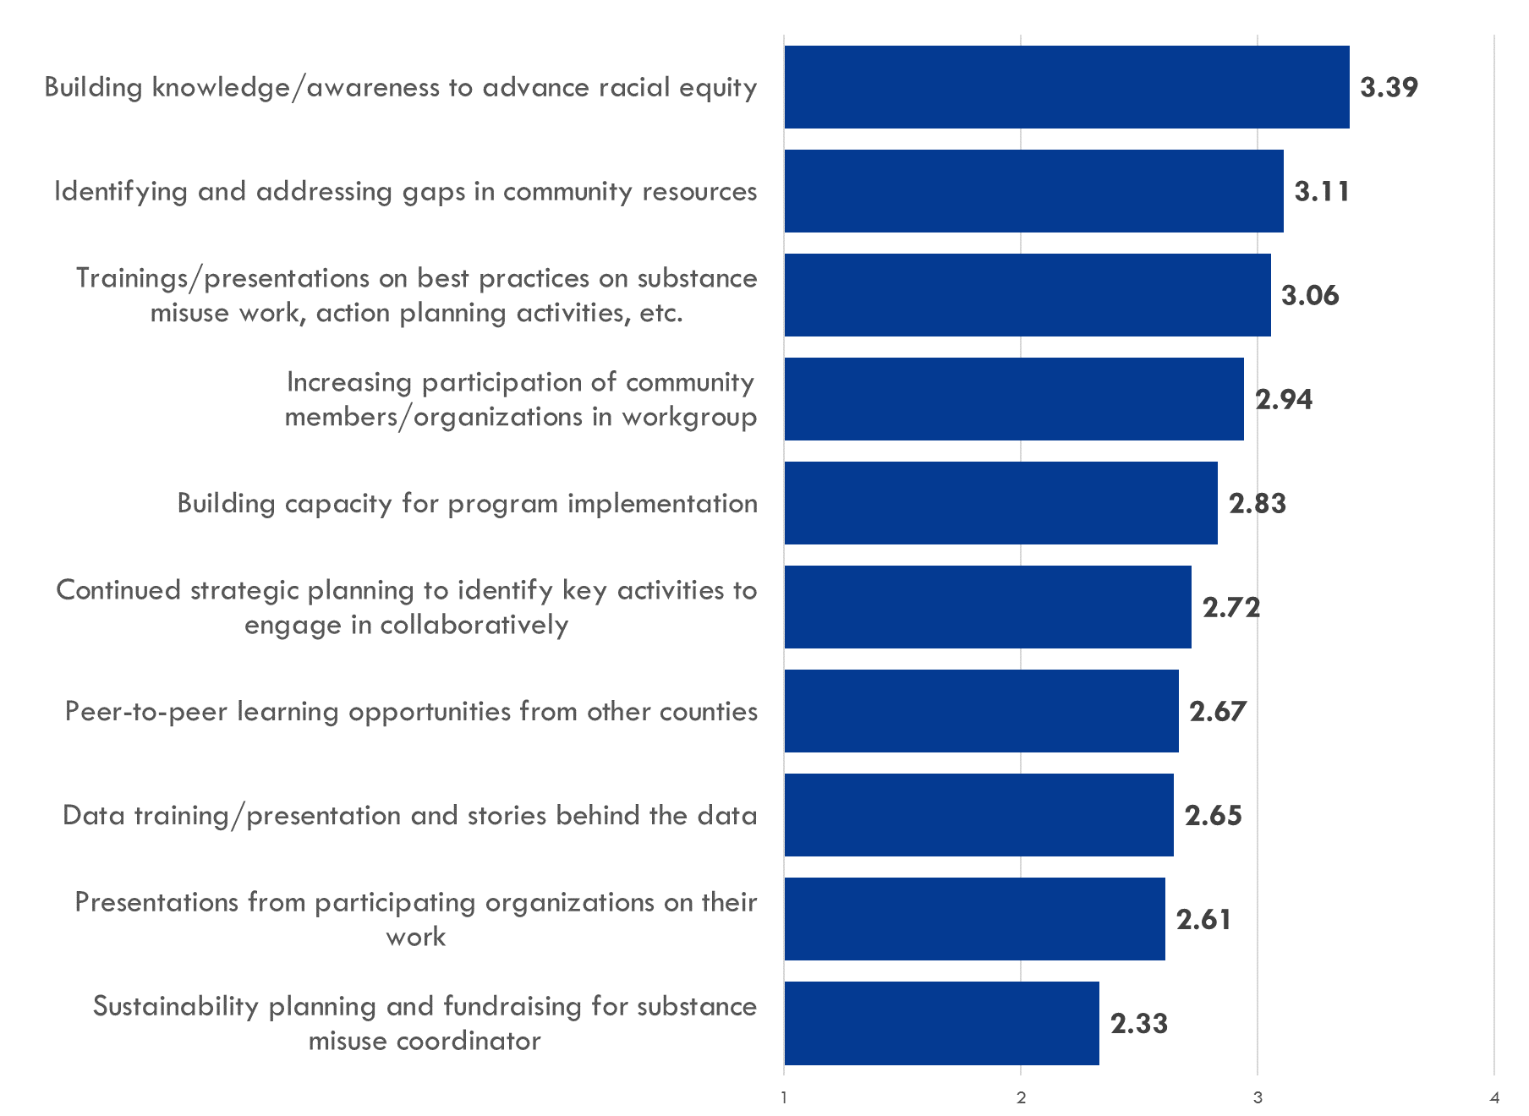
Survey Results
Future directions
Racial equity awareness
Address resource gaps in community
Trainings on best practices for substance misuse work
Building and strengthening the workgroup network for program implementation
Notes:
The results have provided us and especially the leadership team of an understanding of where people are right now and what capacity they have. For instance, 70% of people said their work has been impacted by Covid-19, and some noted that this reduced their ability to participate. They also were able to “re vote” in some ways for what were now more urgent community needs: Not scrapping what had come before, but as a way to proceed in the midst of a global pandemic and continue building on the work we had already done while leaving room for adjustment due to any changes in priorities.

Slide 20
Key Takeaways: Community Work
Prioritizing action steps: The challenge and need to balance a sense of overall urgency in the work with meeting the needs of a community in crisis and preventing burnout among providers
Processes not linear: Finding ways to develop tools that build on previous planning processes and also recognize and support what feels feasible and necessary now
Following community leadership: continue to meet community where they are and work to educate funders when the timeline and work plan don’t match initial proposal
Notes:
So, what are our key takeaways. I would say one is that while prioritizing action steps, the challenge is to balance a sense of overall urgency in the work (substance use strategic planning overall) with meeting the needs of a community in crisis and preventing overwhelm and burnout among providers. As a capacity building TA team, we can’t do all of that ourselves, but we can try to help the community organization prioritize their “do nows” and their “do laters” in a way that gives them manageable chunks to bite off; A point of tension and frustration, though, is that we don’t hold the keys and can’t make the work actually happen.
We are fortunate to have a funder that understands community work, that it’s complicated and messy, that sometimes it isn’t linear and sustained because staff turnover in an organization may shift their priorities. But, through trust and communication, we also play a role in exchanging insight with them as we are in dialogue over strategies and priorities and how the work is proceding when it doesn’t always match the initial proposal.

Slide 21
Key Takeaways: Cross-institutional TA
Successful collaboration has relied on shared power dynamics between the partners and the workgroup
Shared power & community autonomy is critical
Flexibility and responsiveness to community direction made pivot to COVID-19 possible
Cross-institutional academic collaboration leveraged the skills & expertise of various organizations
Cross-institutional collaborative made for an adaptive and responsive model for continued support during COVID-19
COVID-19 challenges were dispersed across multiple agencies, rather than absorbed by a single agency
Notes:
Cross-institutional partnerships made the TA team more nimble and able to adapt to the situation more than a single agency. For example, had it been myself and John alone, we would not have had the expertise that NCCHW and Rural Forward brought with them! Ability to move to an online platform, facilitate breakout rooms, and then collect the data to re-focus when the Workgroup was ready.
OUR work wasn’t interrupted by the pandemic, given the community-led nature of leadership, as it might have been from a more research focused project. However, that’s also the limitation of our work, right? Without strong internal leadership, even a lot technical expertise and capacity from a team can only get you so far; Covid-19 and other factors impacted the community’s ability to lead this work now.
One key area I believe our work contributed to has been helping keep a group of people and organizations with different priorities working together in alignment rather than splintering. Substance use is tied to mental health and trauma, and a key questions we saw this group grapple with is “do we focus on prevention or response? When there are limited resources, what social drivers of health do we focus on first, especially when they all intersect? How can we bring a group together with a shared game plan when they are busy putting out fires?”
We’re setting them up for implementation, but capacity is one piece, and true sustainability will still be coming from the group as they develop their backbone agency and coordinator and grow their leadership capacity. We’ve been honored to get to play a supportive role. Thank you so much for listening and I’ll turn it back to Jessica.

Slide 22
sph.unc.edu/nciph
facebook.com/uncnciph
linkedin.com/company/nciph

Slide 23
Extra slides

Slide 24
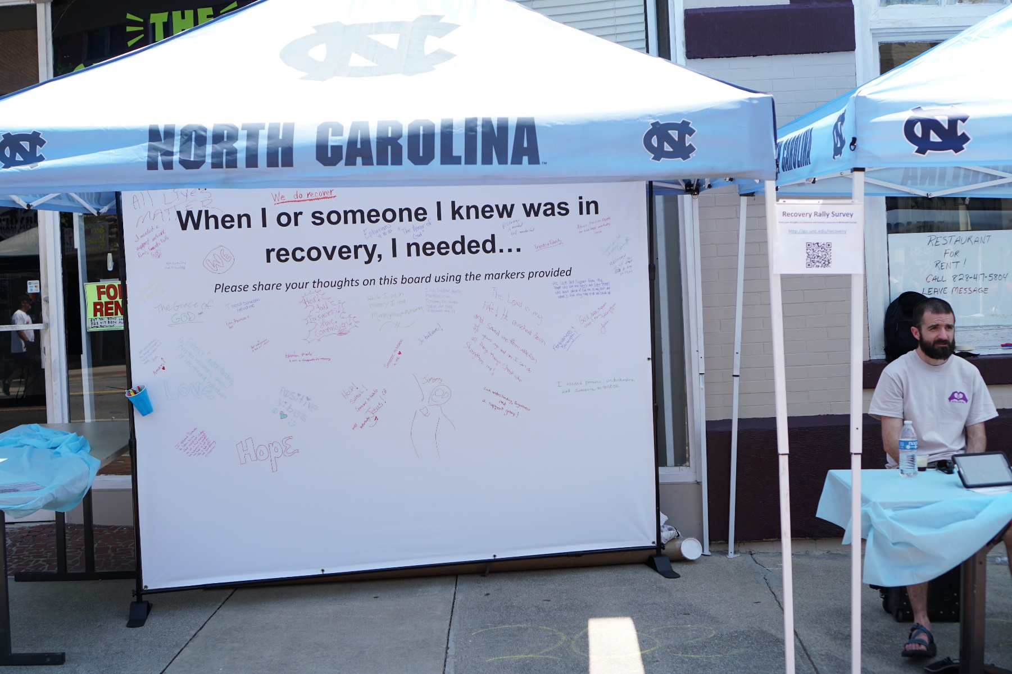
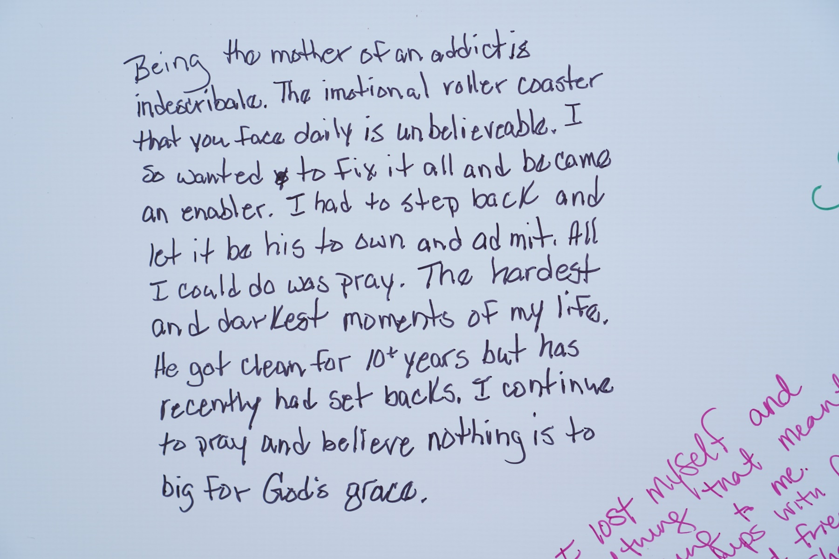
Assessment and Qualitative Data Collection
Community data collection at the Recovery Rally
Notes:
Promoting better data use
To better understand where the community is and to include the broader community voice as a guiding motivator and grounding vision for the workgroup.
We completed a short survey for the Workgroup , as well as displayed banners that people could respond to our prompt or share their thoughts or stories of recovery.

Slide 25
Survey Results
70% of the workgroup reported their participation was affected by COVID-19
Strengths of the workgroup
Member experience
TA & Leadership
Community value
Local subject matter experts participation
Opportunities for the workgroup
Resources
Member experience
Group effectiveness
Value of participation
Shared language
Notes:
Affected: daily job responsibilities had increased, virtual meetings were a challenge, and 44% reported that the strategic planning felt less relevant
Strengths they identified were the member experience (ability for diverse organizations to collaborate, that meetings were useful, and the group was of value to the community)

Slide 26
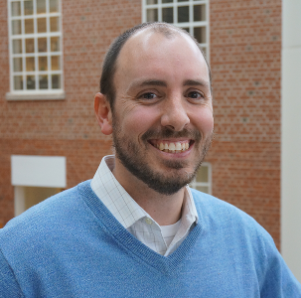
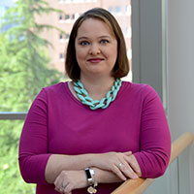
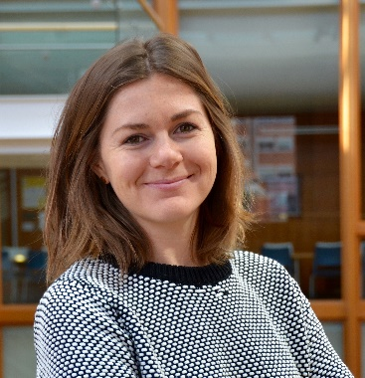
Cross-Institutional Collaboration Staff
John Wallace, PhD, MSPH Primary Investigator, NCIPH
Emma Olson, MSW, MPH NCCHW
Amy Belflower Thomas, DrPH, MHA, MSPH Primary Investigator, NCIPH
Amy Lanou, PhD NCCHW
Erin Magee, MSW, MPH NCIPH
Kathryn Gaasch, MEM Rural Forward NC

Slide 27
Identifying Strategies
Summarize Community Inputs
Community Health Assessment 2018
Community Recommendations and Strategy
Whole Distance Exercise
North Carolina Opioid Action Plan 2017-2021
Form Action Workgroups
Cross walked community inputs to identify different strategic areas of work
Voted on strategies by impact and feasibility
Formed small work groups based on coalition partners’ interest and expertise
Began process of identifying metrics to measure success and forward motion

Slide 28
Identifying Strategies

Slide 29
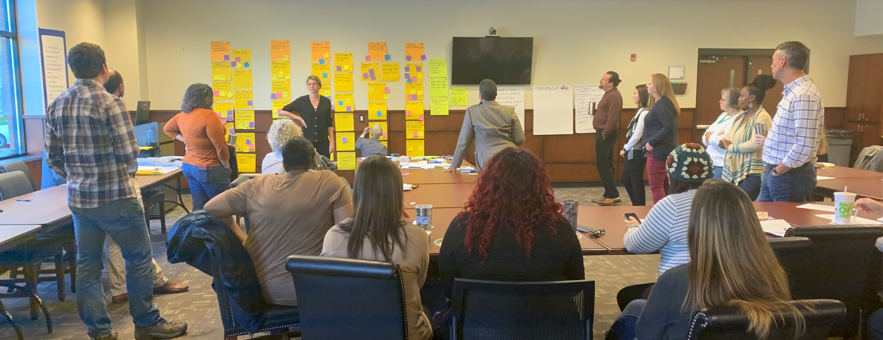
Strategic Planning Process
Notes:
As part of the strategic planning process, one of the first activities the TA team undertook was a “Whole Distance Exercise.” The Whole Distance Exercise is a Results Based Accountability exercise designed to move a large group from results to action.
Bringing alignment

Slide 30
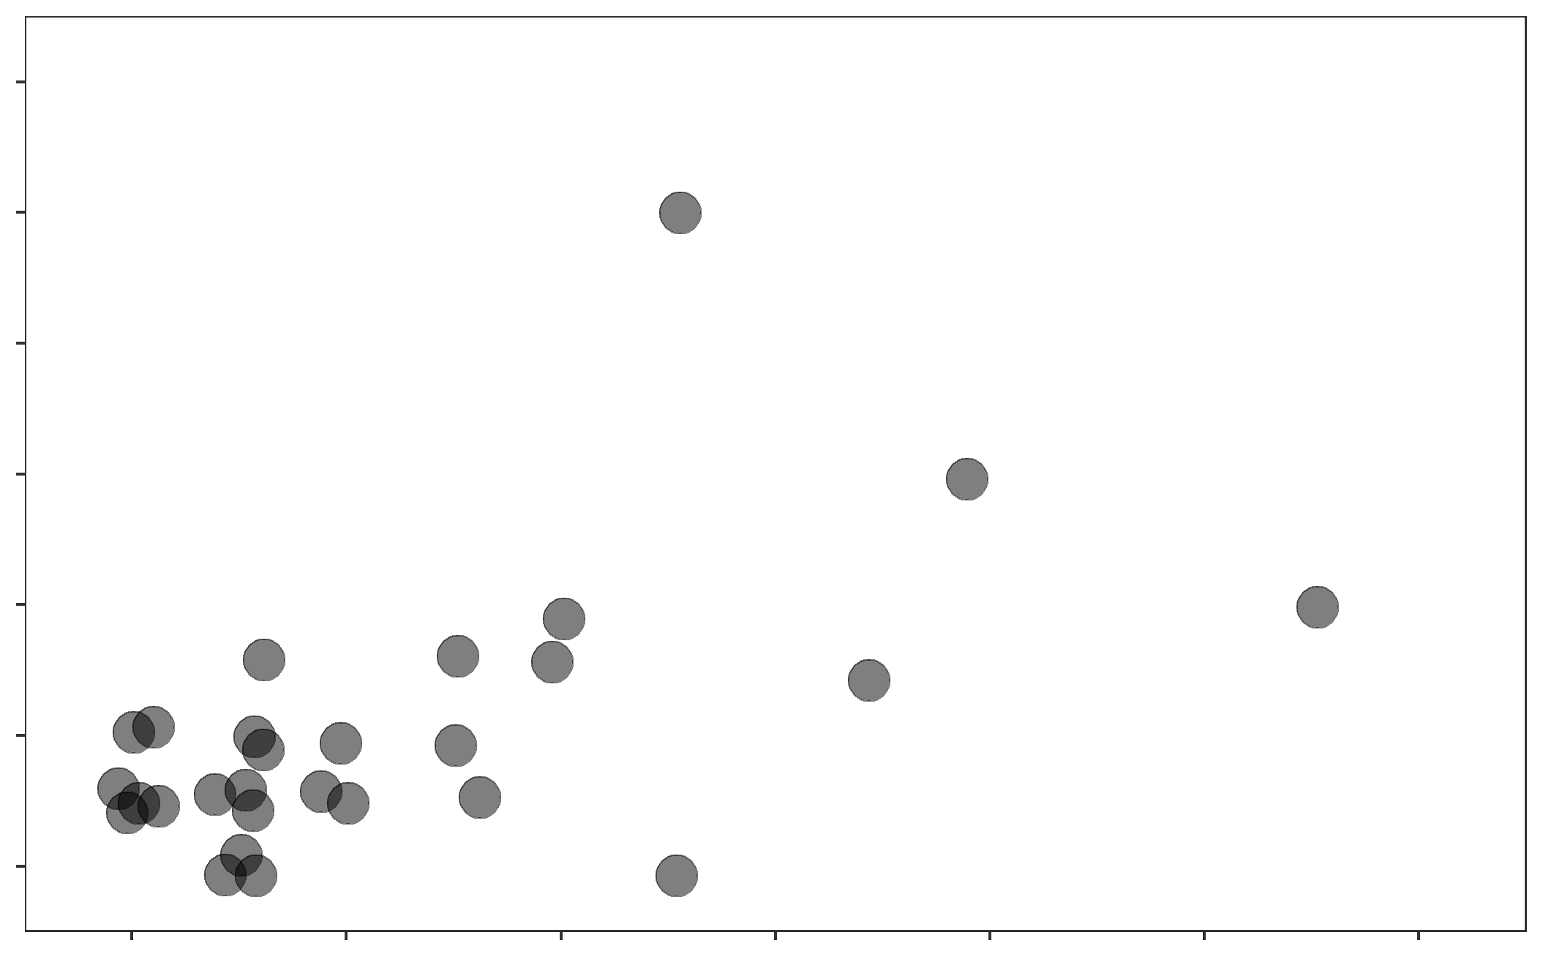
Prioritizing by Impact and Feasibility
Impact & Feasibility of All Strategies That Received Votes
Most Impact
12
28 strategies received at least 1 vote for feasibility/impact
Some strategies begin to emerge as impactful & feasible
8
Impact Votes
4
Least Impact
0
Least Feasible
Feasibility Votes
Most Feasible
0
4
8
12

